Slide 1
Capstone Project Proposals
Elang Setiawan, DSIF 2
Project 1: Object detection for Autonomous robotic cleaner
Project 2: Predicting price of resale HDB units
Project 3: Twitter sentiment analysis of Emma Raducanu
1

Slide 2
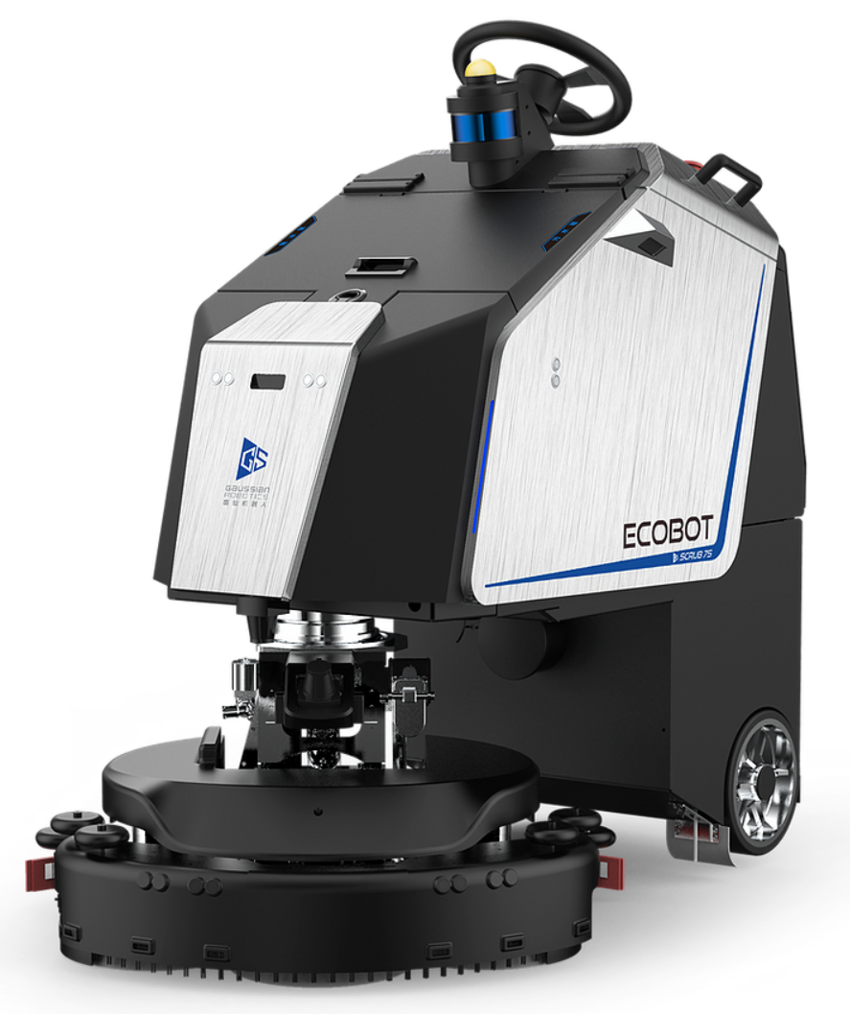
Project 1: Object detection for Autonomous robotic cleaner
An autonomous robotic cleaner travels around an area to clean the floor. By attaching a camera on the robot, the robot is able to spot large objects, such as bag, package or rubbish, and alert a cleaner or a security guard for further action.
The project is to design a computer vision model to identify objects from pictures that the camera captures.
The target audience is the company selling the robots as feature
enhancement of the existing product.
The project will use detectron2 library from facebook,
and publicly available image datasets from kaggle, google etc.
This project was a discussion during an interview.

Slide 3




Project 2: Predicting price of resale HDB units
SRX.com.sg provides an automated property valuation called X-value that is determined using features including distance from the nearest MRT station.
The project is to predict the price of a resale HDB unit.
The target audience is property portal such as srx, 99co, ohmyhome.
The HDB resale data is available from data.gov.sg and
distance related data is available from www.onemap.gov.sg.
This project will be part of project portfolio during job interview.

Slide 4
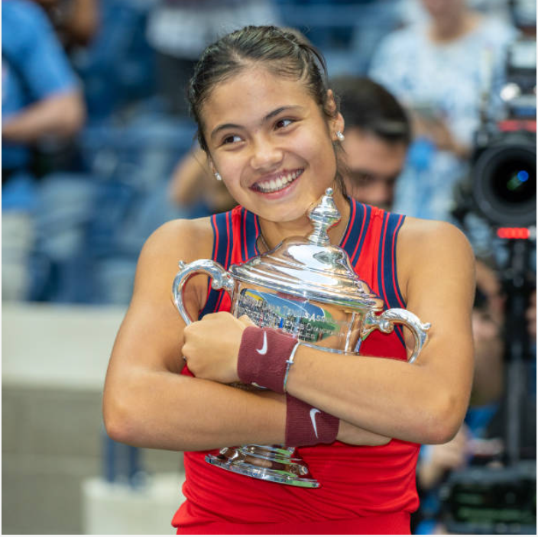
Project 3: Twitter sentiment analysis of Emma Raducanu
Emma Raducanu is an 18 years old women US Open 2021 winner. The British citizen with Romanian and Chinese parents, born in Canada and arrived in Great Britain at 2 years old, played 10 games from qualifier without losing one single set.
The project is to design a sentiment analysis model from twitter feed with hashtag #EmmaRaducanu.
The target audience is sports personality management company
for advertising and endorsement interest.
The project will use kaggle dataset of collected tweet data https://www.kaggle.com/gpreda/emma-raducanu,
with additional data extracted using twitter API and tweepy.
This project will be part of project portfolio during job interview.

Slide 5
Questions?

